Slide 1
DRIVER DROWSINESS DETECTION SYSTEM
Project Work Phase-2 Final Presentation
Presented by
Batch No:12
Chethan Holla B V (1AY18IS030) Gagan P Gupta (1AY18IS041) Keerthi I G (1AY18IS052) Malipeddu Harsha vardhan (1AY18IS063)
Under the guidance of
Prof. Chaitra B
Assistant Professor
1

Slide 2
Agenda
Abstract
Introduction
Problem Statement
Proposed System
Methodology
Requirement Specifications
Design
Implementation
Results and Discussion
Testing
Applications
Conclusions & Future Enhancements
References

Slide 3
Abstract
In Today’s modern world Transportation is necessary for the development of the society.
There has been many advancement made towards the development of transportation and automobile field, but some effort should also be made to prevent the accidents that happen frequently these days. So road safety becomes a very important aspect for any driver.
The majority of accidents happen due to the drowsiness of the driver. So, to prevent these accidents we will build a system using Python, OpenCv and Arduino which will alert the driver when he feels drowsy.

Slide 4
Introduction
Drowsiness is one of the major cause for the accidents.
Every year 10 to 15% of the accidents are due to driver drowsiness.
The drowsiness can be defined as a transition from awake state to sleep state.
The aim of this project is to develop a drowsiness detection system.
The focus will be placed on designing a system that will monitor the open or closed state of the eyes and mouth in real-time. Once the drowsiness is confirmed a buzzer and speaker will be raised .

Slide 5
Problem Statement
The proposed system works based on Machine Learning and it deals with implementation of an automated system which helps us to detect the driver drowsiness using Digital Image Processing technique.

Slide 6
Requirement Specifications
HARDWARE REQUIREMENTS
System : intel i3/i5 2.4 GHz.
Hard Disk : 500 GB
Ram : 4/8 GB
SOFTWARE REQUIREMENTS
Operating system : Windows XP/ Windows 7.
Software Tool : Open CV
Coding Language : Python 3.7.0

Slide 7
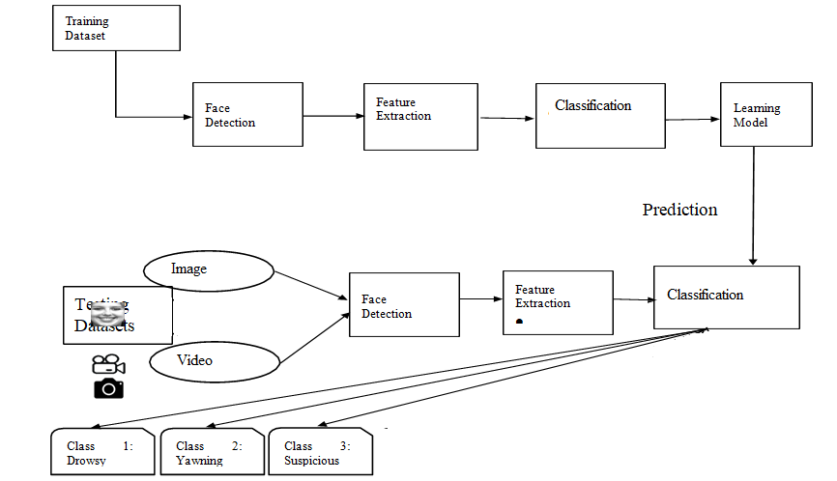
Design
Test Dataset
Data Flow Diagram

Slide 8

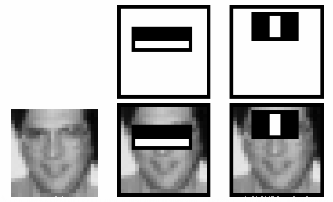
Proposed System
Proposed system follows the Haar cascade for capturing the faces in real time video.
It uses Dlib library facial land marks for the calculation of the eye ratio, yawing ratio, head movement etc.

Slide 9
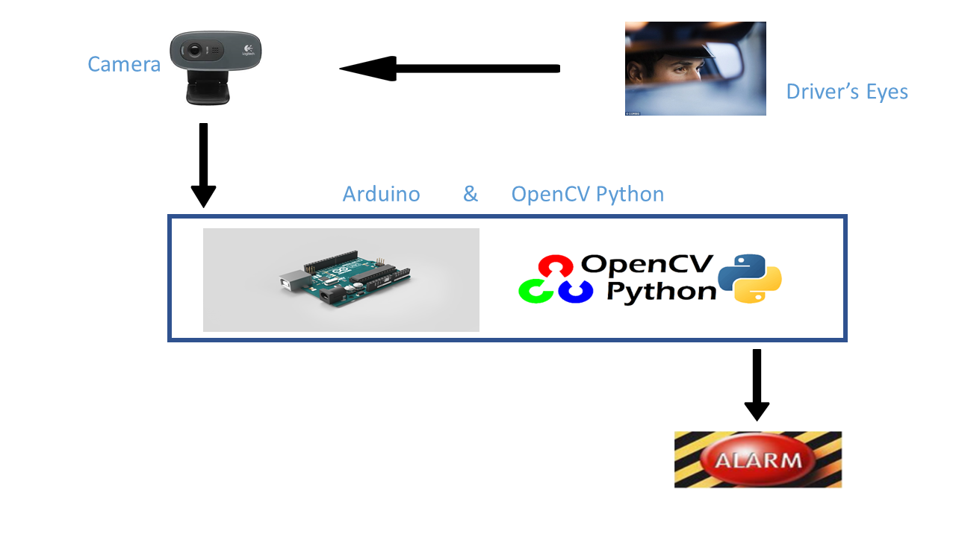
Implementation

Slide 10
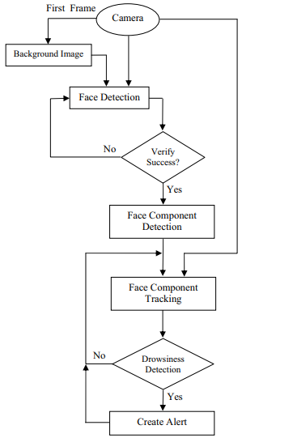

Slide 11
In this project solution are obtained using software and hardware components to achieving the results of driver drowsiness detection.
Through face visualization one can identify facial expressions like eye movements, head movements and mouth movements analysis.
Making a real time application using computer vision is found to be more efficient and creative task that needs processing accuracy of the system.
OpenCV is freely available software, which is used to creating computer vision. OpenCV is used in many programming languages like C, C++, and Python. It supports many interfacing like low level and high level peripherals that contains USB camera.

Slide 12
Driver drowsiness action are detected and sends a message and alerts the driver by giving alarm.
We are using facial landmark algorithm and Haar Feature based Cascade technique, it is a machine learning approach where a cascade function is trained from a lot of positive and negative images.
Once the image is detected the following actions are considered head movements, eye movements, mouth movements.
Facial landmark algorithm for localizing points on face and Euclidian method.
Consider an example if eyes width decreases to 2.5 or 3 seconds, detection of driver fatigue.

Slide 13
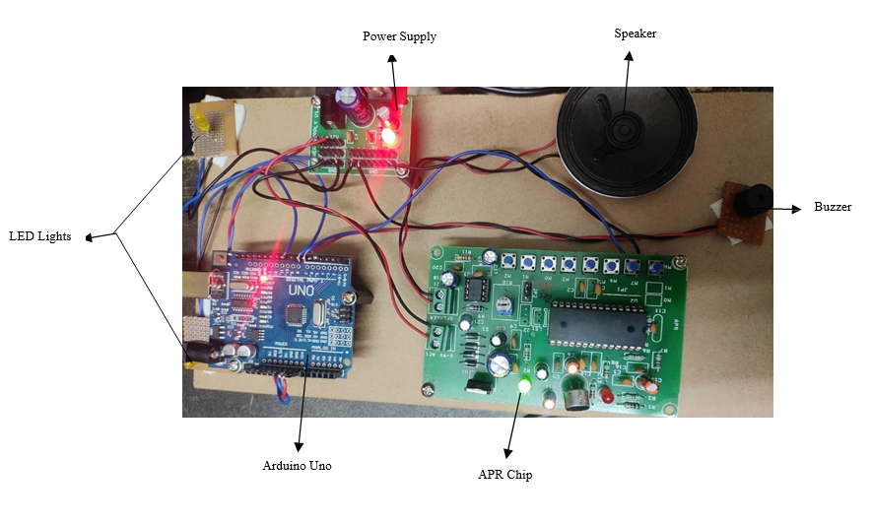
HARDWARE IMPLEMENTED :

Slide 14
Hardware used:
Arduino UNO
APR Chip
Speaker
Buzzer
2 LED Light (Hazard Light)
Power Supply

Slide 15
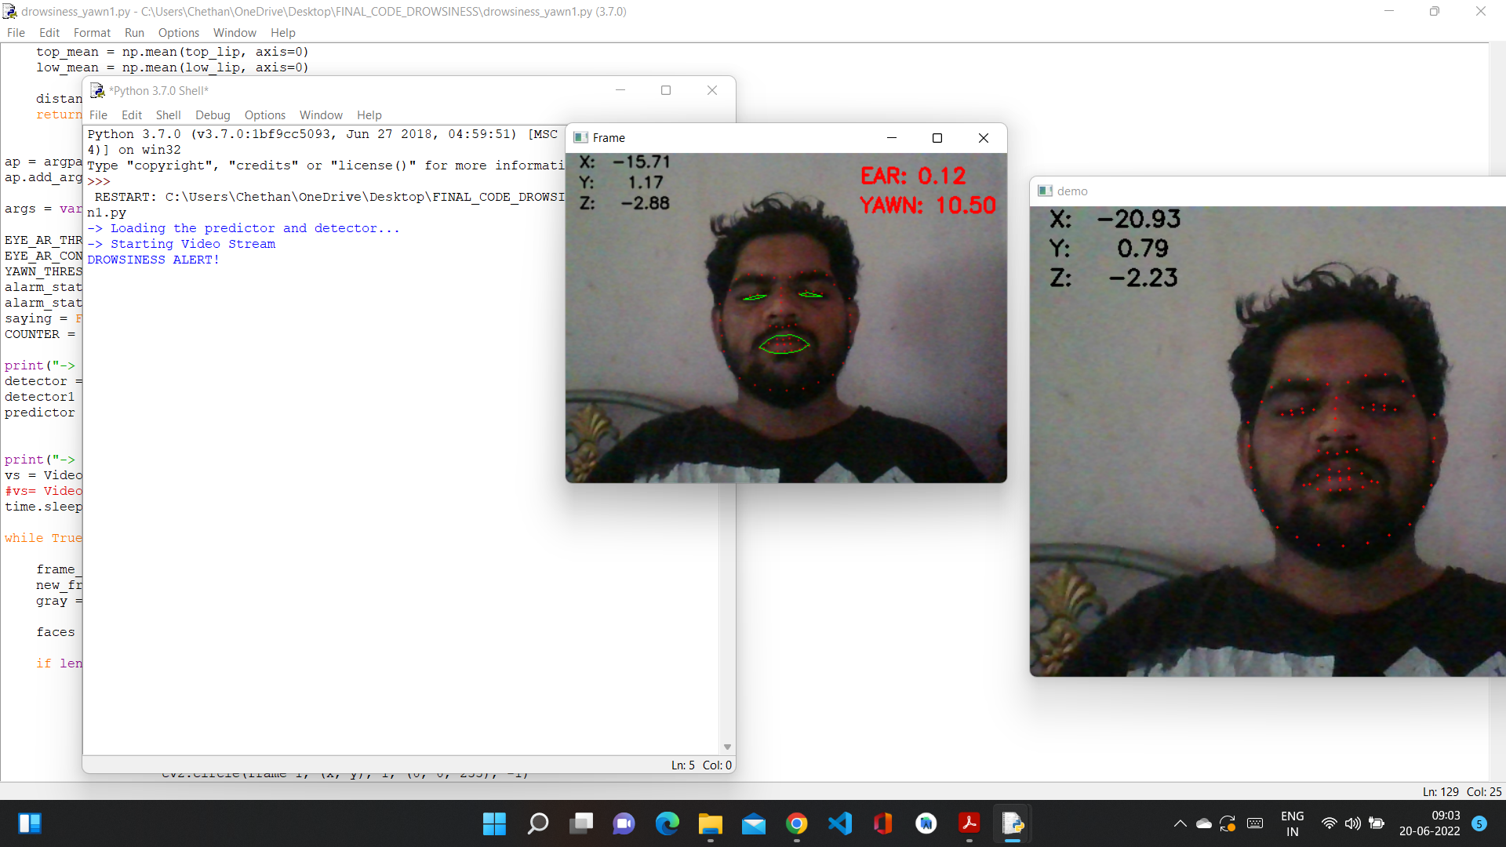
Results

Slide 16
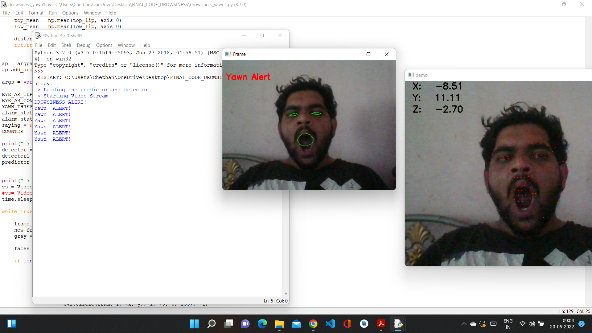

Slide 17
Testing
Testing is the process of evaluating a system or its component(s) with the intent to find whether it satisfies the specified requirements or not.
1. Black-Box Testing
The technique of testing without having any knowledge of the interior workings of the application is called black-box testing.
2. White-Box Testing
White-box testing is the detailed investigation of internal logic and structure of the code

Slide 18
Unit Testing
The goal of unit testing is to isolate each part of the program and show that individual parts are correct in terms of requirements and functionality. Test cases and results are shown in the Tables.
Sl # Test Case : - | UTC-1
Name of Test: - | Image or video capture
Items being tested: - | Input Image
Sample Input: - | Camera Stream
Expected output: - | Should Capture input image
Actual output: - | Image Captured Successful
Remarks: - | Pass.
Sl # Test Case : - | UTC-2
Name of Test: - | Eye Detection
Items being tested: - | Labelling
Sample Input: - | Image or video
Expected output: - | Eye Should detected as facial Landmark
Actual output: - | Facial Landmark is detected
Remarks: - | Test Passed

Slide 19
Applications
It has fully automated operations, without any human intervention.
No one can manipulate the data sent by the device to the owner.
It is cost-effective.
Accidents due to drowsiness can be avoided.

Slide 20
Conclusions and Future Enhancements
In this paper, In the present research we have presented the application of computer vision with embedded systems
Targeted for reducing road accidents due to driver drowsiness.
Monitoring and detecting the driver’s behavior to ensure road safety is important because road accidents take place.
Hence it is important to capture driver behavior which will control the accidents due to rash driving under the influence drowsiness
We need to add detection of Alcohol using sensors and Add break light features to this system.

Slide 21
References
https://www.javatpoint.com/flask-tutorial
https://www.w3schools.com/python/python_ml_train_test.asp
https://docs.opencv.org/4.x/index.html
https://en.wikipedia.org/wiki/Haar_wavelet

Slide 22


Slide 23


